Slide 1

Library Management System
(E2 - 8)
Foundations of Programming-CSE10010
Mini Project Presentation 2025-26
Team Members
Ridhima Lunawat (1262252148)
Shreya Landage (1262252459)
Tanisha Botre (1262252364)
Rutvik Vairagi (1262252145)
Swanand Hagwane (1262251674)
Guided By
Anushri Kulkarni Ma’am
Shirish Paygude Sir

Slide 2
Content
Introduction and Motivation
Problem Statement and Objectives
Individual Contribution
Summary of Literature Survey
Proposed System
Hardware and Software Requirements
Implementation and Experimental Setup
Results and Conclusions
References

Slide 3
Introduction and Motivation
Libraries are essential institutions that provide access to knowledge and resources. However, managing library operations manually — tracking book availability, handling issue/return records, and maintaining user data — is time-consuming and error-prone.
This project presents a console-based Library Management System developed in C, using two key data structures: a book struct (name, author, 3 genres, quantity) and a UserProfile struct (name, password, age, college, branch, issued slots, issue/due dates, and read history). All data is persisted in text files using fscanf/fprintf.
The motivation is to apply core C programming concepts — structures, file I/O, string handling, and modular functions — to solve a real-world problem. The system supports up to 100 book records and 50 reserved books in memory, with all operations backed by persistent .txt files.

Slide 4
Problem Statement and Objectives
Problem Statement: Traditional library management relies on manual record-keeping, which leads to inefficiencies such as loss of issue records, difficulty tracking availability, and lack of personalized services for users.
Objectives:
Secure login with 3-attempt limit (credentials checked against user_data.txt)
Create and Delete user accounts, persisted in user_data.txt
Search books by Name, Author, or Genre using strcmp() exact-match
Issue books: up to 3-book limit per user; auto-calculates 7-day due date via time.h
Return books: updates issued_books.txt status to returned with return date recorded
Donate books: adds new entry or increments quantity if duplicate found
Profile page: view books read/issued (up to 50 history), due dates, membership details
Book suggestions: by genre match, bestsellers (quantity=0), or upcoming 2026 titles

Slide 5
Individual Contribution
Name | Work (Report/Presentation/Algorithm Design/Implementation)
Ridhima Lunawat | Presentation & implementation
Shreya Landage | Report & implementation
Tanisha Botre | Implementation
Rutvik Vairagi | Implementation
Swanand Hagwane | Implementation

Slide 6
Summary of Literature Survey
Paper Ref. (as per order of references) | Title of Paper | Method Used | How is it useful for your project
Ref[1] | The C programming Language – Kernighan & Ritchie | Structured programming, file I/O, pointer | Provided the foundation for using structs, file handling with fscanf/fprintf, and string operations used throughout the project
Ref[2] | Library Management System using C - GeeksforGeeks | Menu driven console application with arrays and structs | Gave insight into how book records and user data can be organized and managed using arrays of structs in C

Slide 7
Proposed System
Detailed Description
Data Structures: book struct {book_name[50], author[50], genre1/2/3[20], quantity} and UserProfile struct {name, password, age, college, branch, issued_slots[3][50], issue_dates[3][20], due_dates[3][20], read_book_names[50][50], books_read, books_issued, payment_per_month, deposit}
Global State: books[100] array, total_records counter, reserved_books[50], total_reserved counter, single UserProfile user loaded at login
File Persistence: DATASET.txt (book records, CSV: name,author,g1,g2,g3,qty), user_data.txt (user credentials/profile), issued_books.txt (issue/return history with status field)
Menu Flow: Startup menu (Login/Create/Delete/Exit) → Login (3 attempts) → Main menu (7 options) via do-while loop calling modular functions

Slide 8
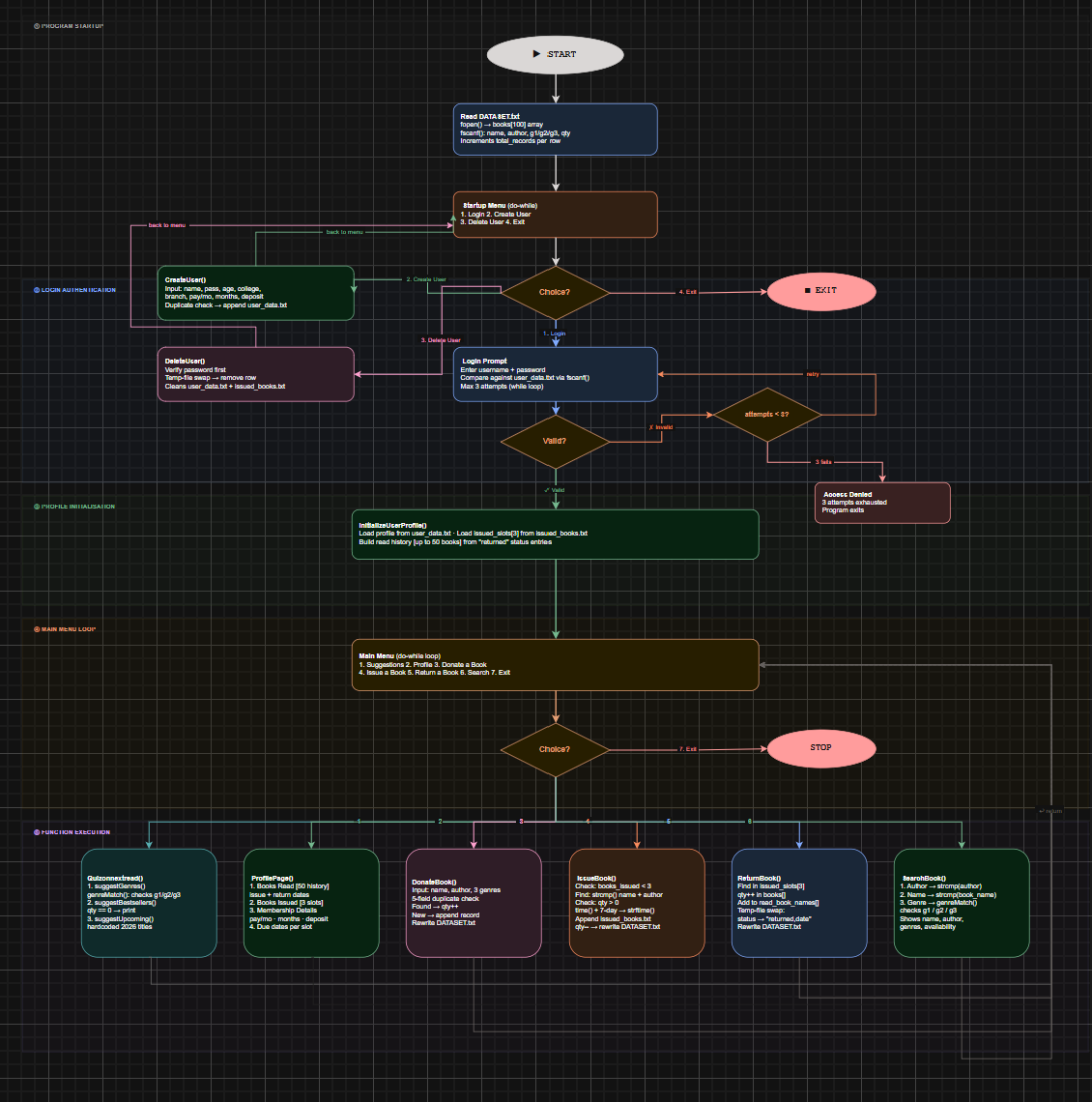
Flowchart

Slide 9
Hardware and Software Requirements
Hardware | Model | Justification w.r.t project
PC/Laptop | Any standard configuration | Required to compile and execute program
Storage Device | HDD / SDD | Stores the dataset files
Keyboard | Standard | Required for user input
Software | Justification w.r.t project
GCC Compiler | Used to compile C source code
Dev C++/ VS code / Code::Blocks | IDE used for writing, editing and running program

Slide 10
Implementation and Experimental Setup
Implementation: main() reads DATASET.txt via fscanf into books[100]. InitializeUserProfile() then loads user profile from user_data.txt and parses issued_books.txt to populate issued_slots[3] and read history.
Login uses a while loop (max 3 attempts), reading credentials line-by-line from user_data.txt via fscanf. After login, a do-while main menu loop drives 7 function calls. File updates use temp file + remove() + rename() pattern to safely rewrite records.
readInt() validates integer input in a while loop to prevent invalid/negative entries. Strings use fgets() + strcspn() to strip newlines. genreMatch() checks all 3 genre fields. suggestBestsellers() lists books where quantity==0.
Key implementation highlights :
IssueBook(): time() + localtime() for dates; +7 days for due date; 3-slot limit enforced; updates DATASET.txt & appends to issued_books.txt
ReturnBook(): line-by-line read into temp_issued.txt; matched entry status changed to 'returned' + date; temp file replaces original
SearchBook(): strcmp(author/name) or genreMatch() across all 3 genre fields; shows stock inline
DonateBook(): 5-field duplicate check; increments qty if found, else new record; rewrites DATASET.txt
CreateUser()/DeleteUser(): CreateUser: duplicate username check; DeleteUser: password verify, removes user row + all issued_books.txt entries
Experimental Setup: Tested on Windows using GCC compiler. Dataset: CSV file with 100+ book records. Test cases: valid/invalid login (3-attempt lockout), issuing up to 3-book limit, returning each book slot, genre/author/name searches with exact and non-matching inputs, donating new and existing books, CreateUser/DeleteUser with correct and wrong passwords, and verifying file updates persist after program restart.

Slide 11
Results and Conclusion
Results: All modules performed correctly. Login blocked access after 3 failed attempts. IssueBook() used time() + 7-day offset for due dates and enforced the 3-slot limit. ReturnBook() rewrote issued_books.txt via temp file swap, updating status to returned with date. SearchBook() matched all 3 filter types via strcmp()/genreMatch(). DonateBook() incremented quantity for duplicates. CreateUser()/DeleteUser() correctly managed user_data.txt and issued_books.txt. ProfilePage displayed all 4 sub-sections correctly.
Conclusion: The Library Management System successfully demonstrates C programming concepts: structs (book, UserProfile), arrays (books[100], issued_slots[3], read_book_names[50]), file I/O (fscanf/fprintf with temp-file-swap pattern), string functions (strcmp, strftime, strcspn, fgets), and the time.h library. The modular design with 10+ functions covers the full library workflow. Future enhancements: overdue fine calculation using date difference, GUI frontend, multi-user concurrent sessions, database backend (SQLite), and a reservation/waitlist system.

Slide 12
References
Ref[1] : B. W. Kernighan and D. M. Ritchie, The C Programming Language, 2nd ed., Prentice Hall, 1988.
Ref[2] : "Library Management System in C," GeeksforGeeks. [Online]. Available: https://www.geeksforgeeks.org
Ref[3] "time.h – C Standard Library," cppreference.com. [Online]. Available: https://en.cppreference.com/w/c/chrono

